Slide 1
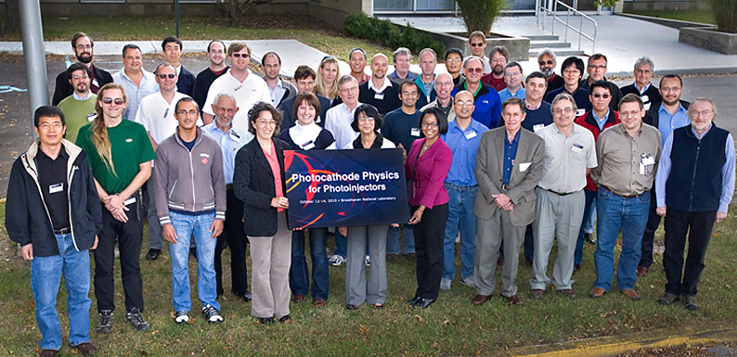
A Summary of the 2010 Photocathode Physics for Photoinjectors Workshop
Ivan Bazarov, David Dowell, *Fay Hannon, Katherine Harkay, Carlos Hernandez Garcia, Howard Padmore, Triveni Rao, John Smedley
* fhannon@jlab.org

Slide 2
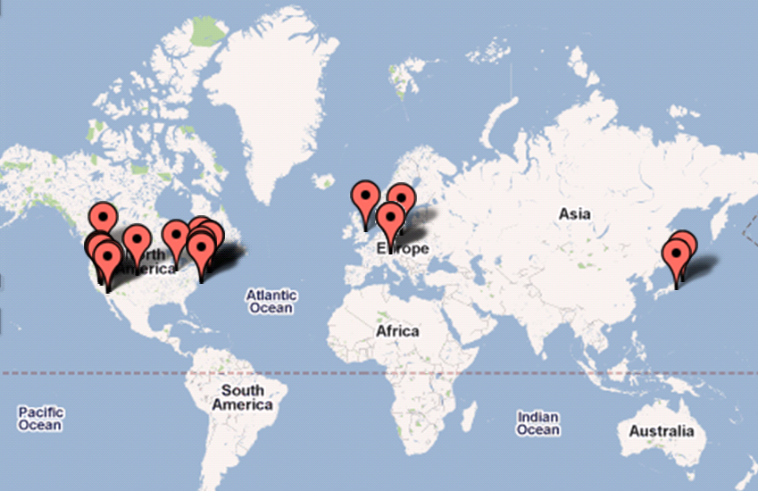
P3 Workshop
Aimed at bringing the photocathode community together to discuss and explore the current state of the art in accelerator photocathodes, from both a theoretical and a materials science perspective.
All types of photocathode materials were discussed, including metals, NEA and PEA semiconductors, and ‘designer‘ photocathodes with bespoke properties.
Share documentation
Learn from our predecessors
http://www.bnl.gov/pppworkshop/
Notes:
Polarized e- not discussed as they have their own forum. But GaAs covered. Not limited by application type – so all photoguns discussed.
Small workshop ~50 people, mainly from US. When look at map – probably should have made more effort to include our Asian colleagues. Photomultiplier tubes – can we learn from the past efforts of others?

Slide 3
Motivation
Interest in photocathodes for accelerators increased dramatically
Present knowledge isn’t adequate
Look beyond empirically found results
Need to understand the fundamental physics of what is happening inside and at the surface
Generate new models for emission
Compare to measurements

Slide 4
Motivation
Think smarter:
Share resources, reduce duplication
Discover most promising materials
How to make better photocathodes, longer lifetime, more robust, resistant to contamination etc.
Build collaborations
Notes:
Increasingly limited funding and resources:
How can we think smarter to achieve these goals
Workshops like this

Slide 5
P3 Structure
Notes:
5 sessions over 2 ½ days

Slide 6
P3 – Session I
Problem Formulation
Requirements for Photocathodes for Photoinjectors (Dowell)
Update the table of requirements from ERL09 workshop. Status reports (Rao)
Comprehensive spreadsheet of Gun/Injector specs/performance & cathode details/ research opportunities (on Indico site)
All talks can be found here:
https://indico.bnl.gov/conferenceDisplay.py?confId=290
Notes:
Understand where we start – baseline platform
Invited all parties to submit status report before workshop so this could be summarised.
See the website for spreadsheet – updated from ERL’09 I think.

Slide 7
P3- Session II
Measurement of Relevant Cathode Parameters
What materials science techniques can tell us about the structure and function of accelerator photocathodes, and allow us to understand how and why their performance degrades. Both for growth and post-mortem studies
In particular:
Angle resolved photoemission spectroscopy (ARPES) gives us access to the "true" intrinsic momentum distribution off of the cathode, and therefore the intrinsic (thermal) emittance.
Diffraction tells us about the structure of grown cathodes, allowing grain size and orientation to be characterized, along with the fraction of the cathode which is actually the desired form (K2CsSb, for example, as opposed to KCs2Sb or K3Sb).
X-ray fluorescence (either x-ray stimulated or electron stimulated) tells us the stoicometric mix of the cathode, and X-ray photoemission spectroscopy (XPS) tells us the chemical bonding.
Overview of techniques: Smedley. Examples and research from Vecchione, Jordan-Sweet, Rameau, Cultrera, Attenkofer, and Chambers
Notes:
What techniques are available to us – and how should we be using them to improve our models and manufacture of photocathodes?
This information is required particularly for the modelling aspect, as this is an iterative process in some sense.

Slide 8
P3 – Session III
Photoemission Physics I: Theory
Global Need: predictive emission models for the calculation of QE that account for emission beyond the present Three-Step Model (TSM) and other related models.
Lot of effort required here
Models to account for each of the following are needed or should be developed: (K. Jensen)
Notes:
Might be of greatest interest as this isn’t really covered in the EUROFEL workshop.
Kevin Jenson gave an update of where this effort is at.
As always with models, a lot of unknowns/assumptions and guess-timates.

Slide 9
P3 – Session III
Within the TSM & Related Models
Transport near surface under band bending (semiconductors) (effect on energy spread/emittance)
Response time (temporal shape) of the emission current
Surface dipole model (esp. for semiconductors) and other factors that affect emission (e.g., plasmon scattering)
Reflectivity and laser penetration depth can be calculated in principle
Usual TSM & related models assume photoemitted electrons haven’t scattered: relax that assumption and find the impact of these electrons
Transmission probability associated surface (related to dipole model as well) treated as a step function, but it is not
Electron trapping at surface – effect on field
Space Charge, band bending effects and relation to external field
Density of States effects

Slide 10
P3 – Session III
Beyond the TSM & Related Models
Variation in emission due to work function changes, varying crystal face, contamination and surface damage/ roughness (due, e.g., to handling, ambient vacuum, cathode cleaning, ion back bombardment) . Thus seeding emittance growth
Incorporate dark current models (aka field emission)
Electron trajectories near the surface of the cathode (related to non-uniform emission and field emission)
Temperature effects due to laser heating (high average current deposits optical energy into crystal), causes heating in semiconductors, and affects QE. Heat removal becomes important
For NEA photocathodes, surface important but largely unknown. Dopant density/graded bandgaps
Fields in vacuum when electrons are emitted
Notes:
Tricky with NEA – who knows what the surface is, what the dipole is? What the affinity is? Need this iteration from measurement.
Can see there are a lot of elements to account for – and which ones have the greatest influence? Which are negligible?

Slide 11
P3 – Session IV
Photoemission Physics II: Agreement with Measurements
Measurements of a) QE vs wavelength; b) thermal emittance, energy spectra; c) response time, are made in injectors, need to compare to material science measurements and theory.
Do differences give clues to emission mechanism with gradient on cathode?
Notes:
In many ways – have been focused here over past years.

Slide 12
P3 – Session V
New Ideas and Future Collaborations
Predominant themes:
Semiconductors are efficient, metals are fast
Cathode coatings to lower work function/improve laser transmission.
Optically enhanced performance : Complete optical absorption, surface plasmon resonance, nano-photonic phenomenon
Multi-photon emission
Notes:
How can we manufacture the best of both worlds?
Enhance QE of metals
fsec photoemission from metals enables
creation of linear space charge fields
access to multiphoton processes

Slide 13
P3 – Session V
Cathode coatings:
MgF2 coated Cu (lower reflectivity)
MgO on Ag(001) (lower work function)
CsBr on Cu, Nb (QE enhancement, postulated intraband states combined with Cs migration)
Pietro Musumeci
Karoly Nemeth
Juan Maldonado

Slide 14
Collaboration
Material science techniques – available at modern user facilities, such as synchtrotron light sources and nano-centers
Methods of vacuum transport or in-situ growth in analysis systems. Can we share load-lock designs?
Cathode recipes - minimize duplication and utilize local expertise
photocathode.org domain is a work in progress, but will be open to the whole community to participate
Notes:
Invite comments from workshop..

